Slide 1
Titanic Survival Prediction Project
Hardik Lakkad

Slide 2
Dataset
Objective
Use supervised classification models to predict passenger survival on the Titanic
Titanic dataset containing passenger details such as age,gender, class, etc..
Goal
Compare model performance to find the best predictor of survival.

Slide 3



Historical Context
The Titanic Tragedy
Societal Impact
Passenger Demographics
Sinking of the RMS Titanic in 1912, one of the deadliest maritime disasters in history.
The Titanic disaster sparked major changes in maritime safety regulations and ship design.
The Titanic carried a diverse mix of passengers from different social classes.

Slide 4
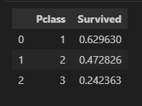
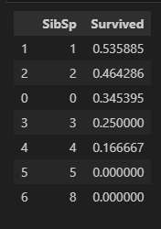
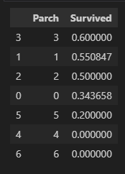
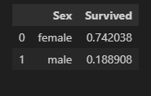
Exploratroy Data Analysis (EDA)

Slide 5
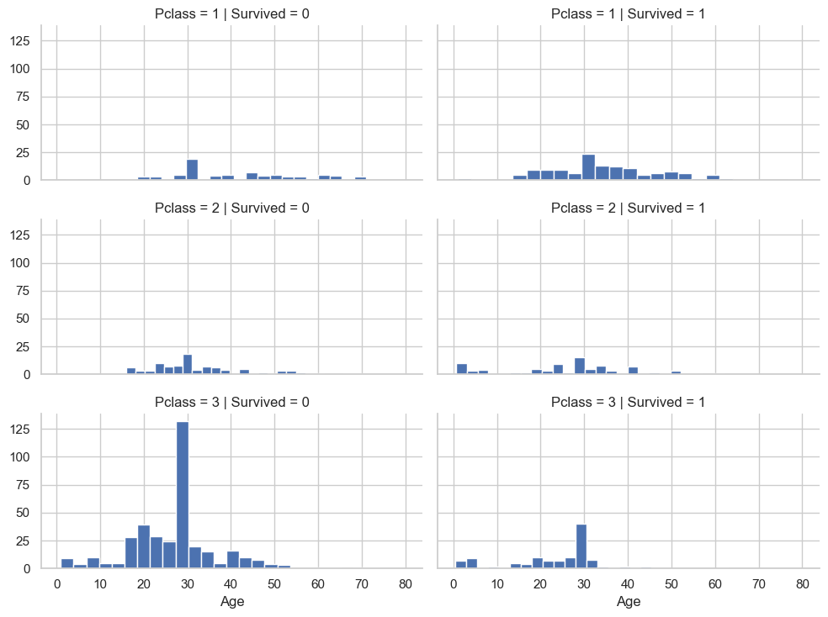

Slide 6
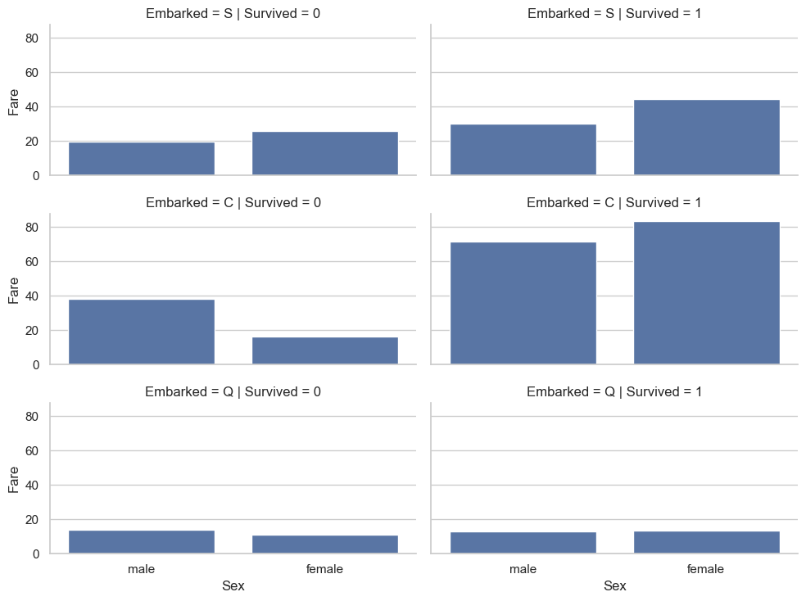

Slide 7
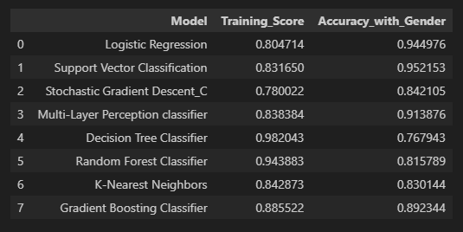
Build and Train Machine Learning Models

Slide 8
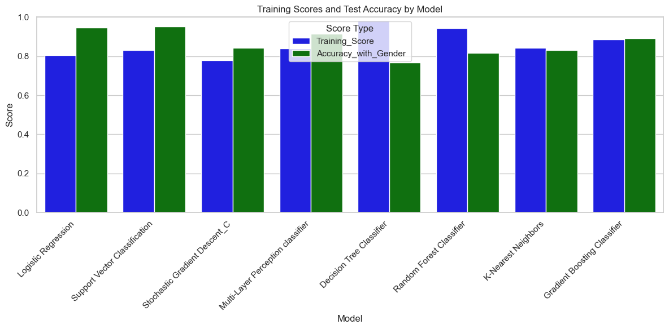

Slide 9
Conclusion
Summary
Logistic Regression and Support Vector Classification showed strong performance.
Complex models like Random Forest and Gradient Boosting may require parameter tuning.
Next Steps:
Hyperparameter tuning for selected models to improve accuracy.
Consider additional feature engineering and possibly adding interactions.

Slide 10
Question & Answer
Thank You

